Slide 1
Chapter 10
Implementing Subprograms

Slide 2
Chapter 10 Topics
The General Semantics of Calls and Returns
Implementing “Simple” Subprograms
Implementing Subprograms with Stack-Dynamic Local Variables
Nested Subprograms
Blocks
Implementing Dynamic Scoping

Slide 3
The General Semantics of Calls and Returns
The subprogram call and return operations of a language are together called its subprogram linkage
A subprogram call has numerous actions associated with it
  Parameter passing methods
  Static local variables
  Execution status of calling program
  Transfer of control
  Subprogram nesting

Slide 4
Implementing “Simple” Subprograms: Call Semantics
Save the execution status of the caller
Carry out the parameter-passing process
Pass the return address to the callee
Transfer control to the callee

Slide 5
Implementing “Simple” Subprograms: Return Semantics
If pass-by-value-result parameters are used, move the current values of those parameters to their corresponding actual parameters
If it is a function, move the functional value to a place the caller can get it
Restore the execution status of the caller
Transfer control back to the caller

Slide 6
Implementing “Simple” Subprograms: Parts
Two separate parts: the actual code and the noncode part (local variables and data that can change)
The format, or layout, of the noncode part of an executing subprogram is called an activation record
An activation record instance is a concrete example of an activation record (the collection of data for a particular subprogram activation)

Slide 7
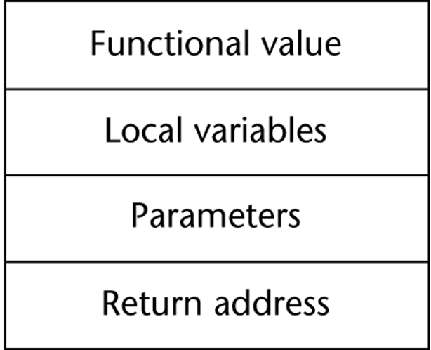
An Activation Record for “Simple” Subprograms

Slide 8
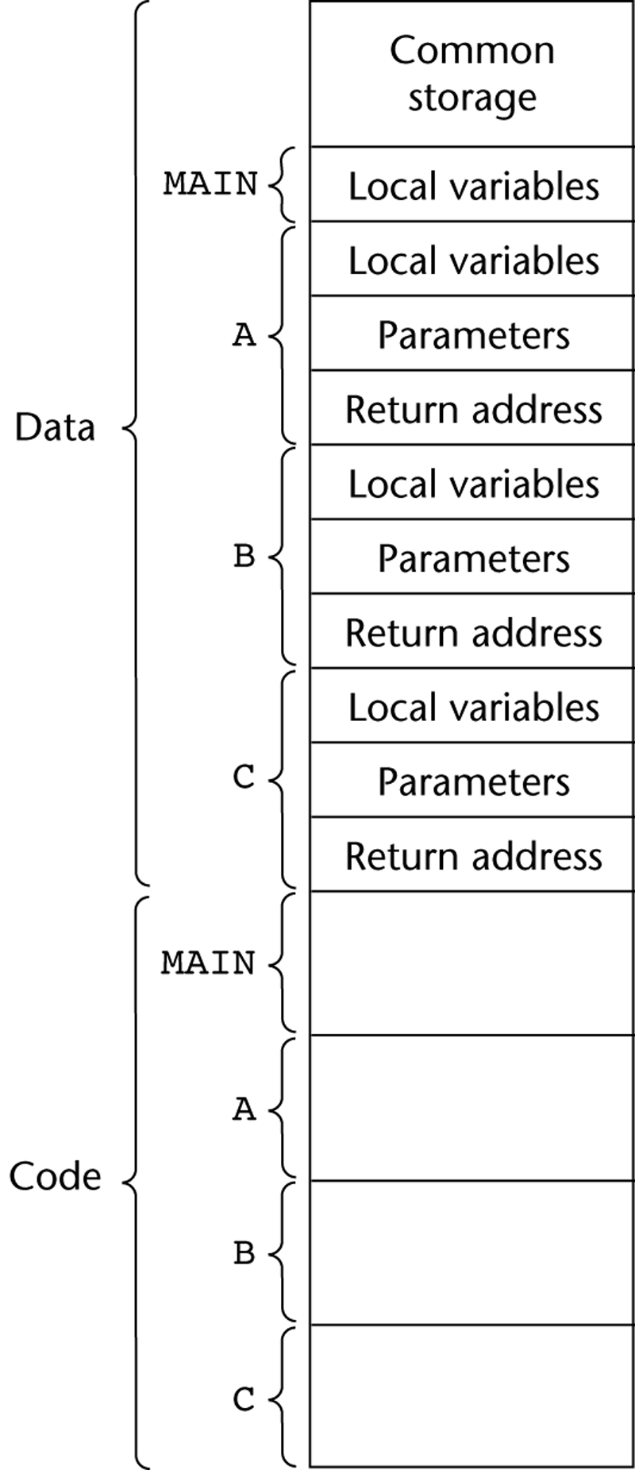
Code and Activation Records of a Program with “Simple” Subprograms

Slide 9
Implementing Subprograms with Stack-Dynamic Local Variables
More complex activation record
  The compiler must generate code to cause implicit allocation and de-allocation of local variables
  Recursion must be supported (adds the possibility of multiple simultaneous activations of a subprogram)

Slide 10
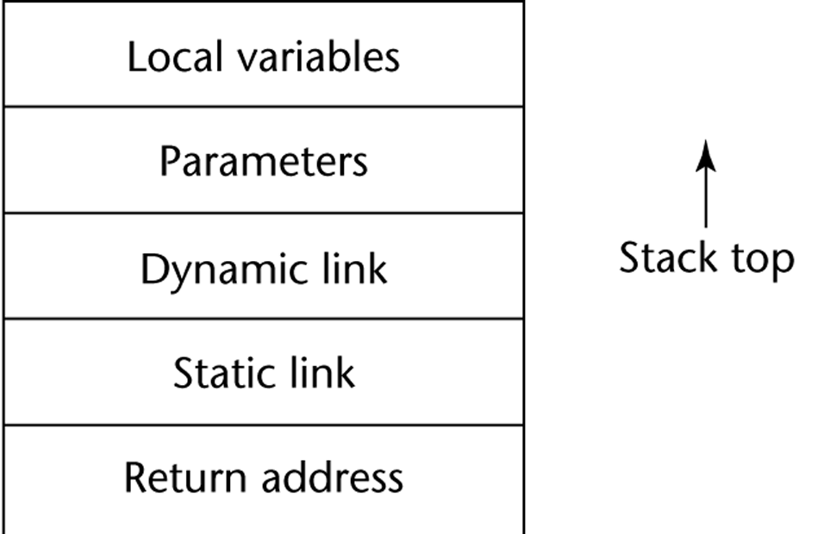
Typical Activation Record for a Language with Stack-Dynamic Local Variables

Slide 11
Implementing Subprograms with Stack-Dynamic Local Variables: Activation Record
The activation record format is static, but its size may be dynamic
The dynamic link points to the top of an instance of the activation record of the caller
An activation record instance is dynamically created when a subprogram is called
Run-time stack

Slide 12
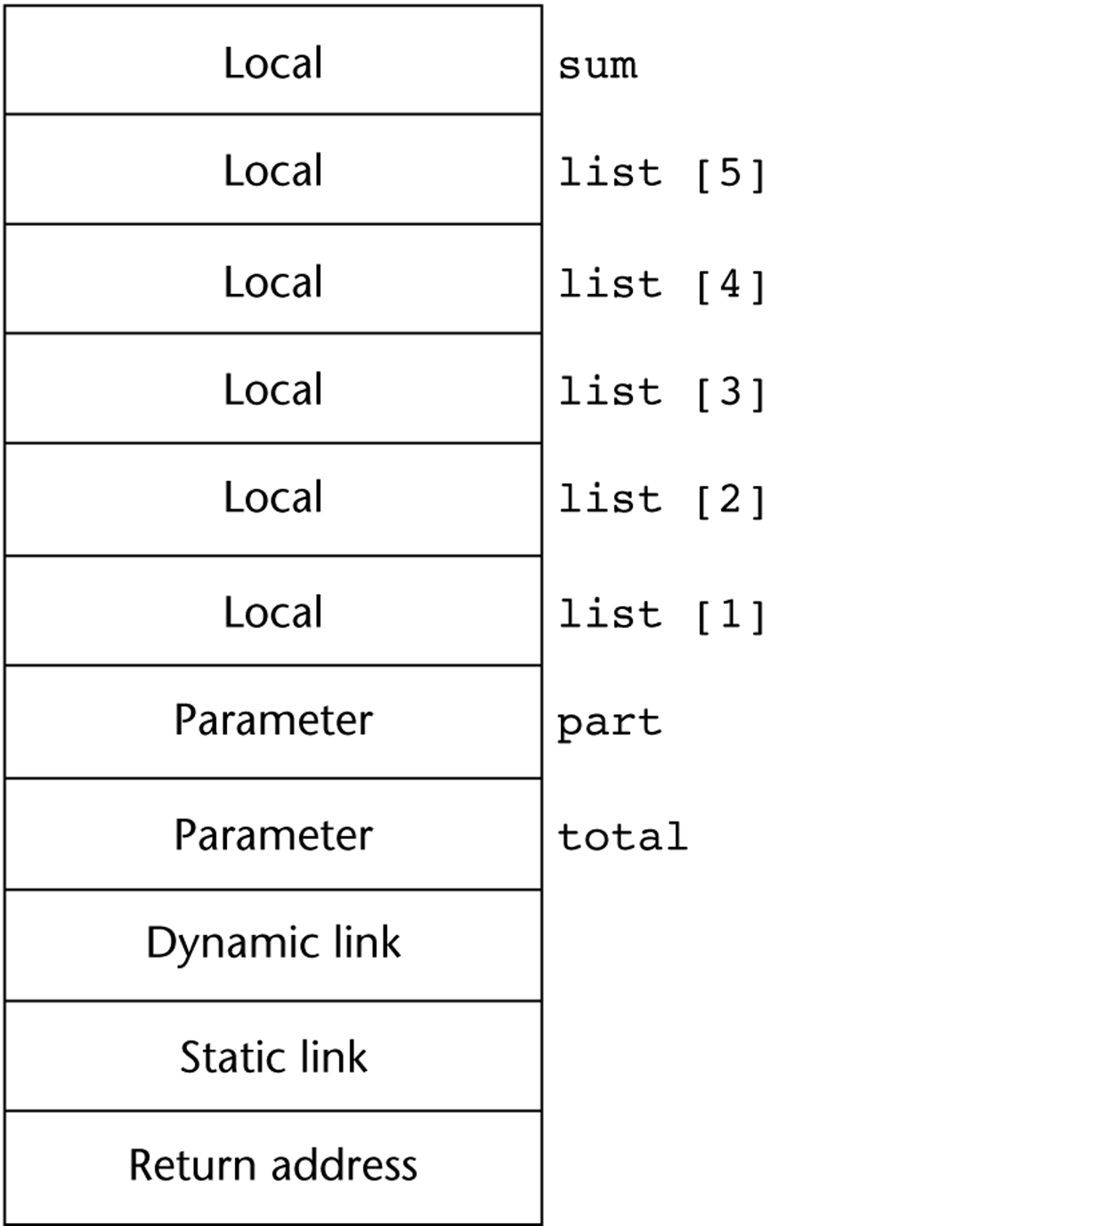
An Example: C Function
void sub(float total, int part)
{
int list[4];
float sum;
…
}
[4]
[3]
[2]
[1]
[0]

Slide 13
An Example Without Recursion
void A(int x) {
int y;
...
C(y);
...
}
void B(float r) {
int s, t;
...
A(s);
...
}
void C(int q) {
...
}
void main() {
float p;
...
B(p);
...
}
main calls B
B calls A
A calls C

Slide 14
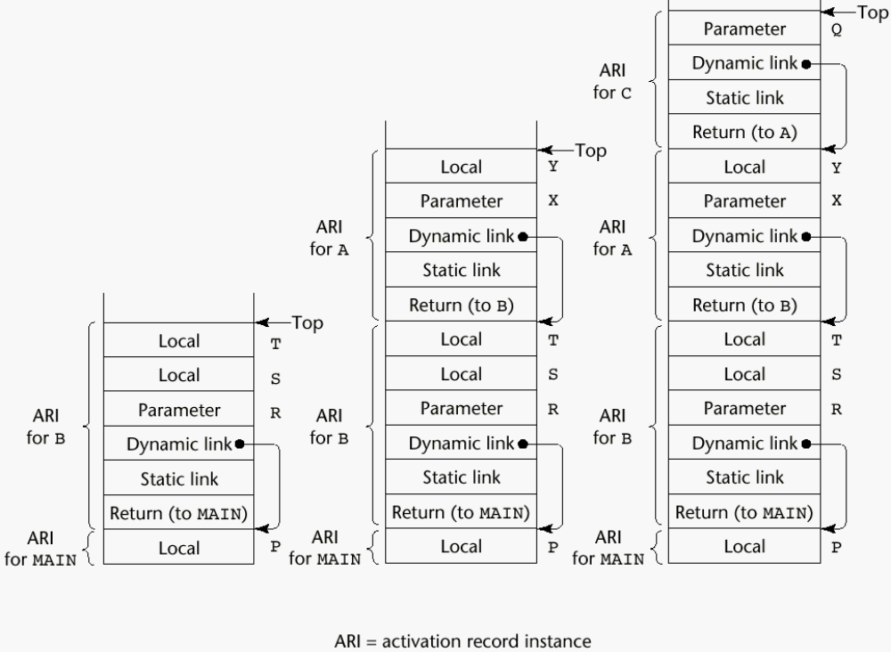
An Example Without Recursion

Slide 15
Dynamic Chain and Local Offset
The collection of dynamic links in the stack at a given time is called the dynamic chain, or call chain
Local variables can be accessed by their offset from the beginning of the activation record. This offset is called the local_offset
The local_offset of a local variable can be determined by the compiler at compile time

Slide 16
An Example With Recursion
The activation record used in the previous example supports recursion, e.g.
int factorial (int n) {
<-----------------------------1
if (n <= 1) return 1;
else return (n * factorial(n - 1));
<-----------------------------2
}
void main() {
int value;
value = factorial(3);
<-----------------------------3
}

Slide 17
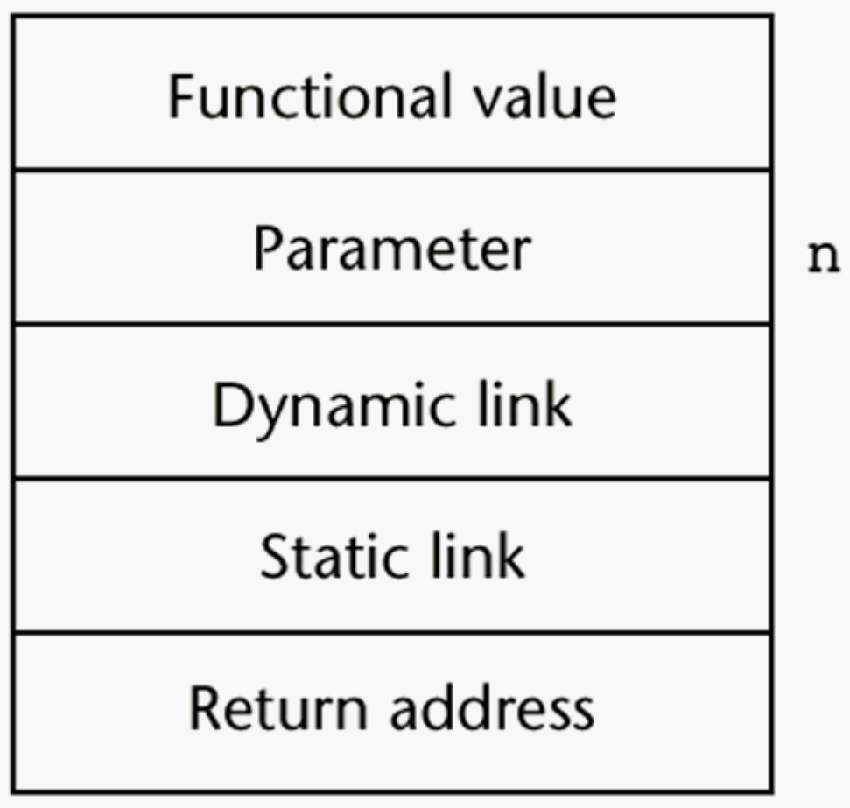
Activation Record for factorial

Slide 18
Nested Subprograms
Some non-C-based static-scoped languages (e.g., Fortran 95, Ada, JavaScript) use stack-dynamic local variables and allow subprograms to be nested
All variables that can be non-locally accessed reside in some activation record instance in the stack
The process of locating a non-local reference:
  Find the correct activation record instance
  Determine the correct offset within that activation record instance

Slide 19
Locating a Non-local Reference
Finding the offset is easy
Finding the correct activation record instance
  Static semantic rules guarantee that all non-local variables that can be referenced have been allocated in some activation record instance that is on the stack when the reference is made

Slide 20
Static Scoping
A static chain is a chain of static links that connects certain activation record instances
The static link in an activation record instance for subprogram A points to one of the activation record instances of A's static parent
The static chain from an activation record instance connects it to all of its static ancestors

Slide 21
Example Pascal Program
program MAIN_2;
var X : integer;
procedure BIGSUB;
var A, B, C : integer;
procedure SUB1;
var A, D : integer;
begin { SUB1 }
A := B + C; <-----------------------1
end; { SUB1 }
procedure SUB2(X : integer);
var B, E : integer;
procedure SUB3;
var C, E : integer;
begin { SUB3 }
SUB1;
E := B + A: <--------------------2
end; { SUB3 }
begin { SUB2 }
SUB3;
A := D + E; <-----------------------3
end; { SUB2 }
begin { BIGSUB }
SUB2(7);
end; { BIGSUB }
begin
BIGSUB;
end; { MAIN_2 }

Slide 22
Example Pascal Program (continued)
Call sequence for MAIN_2
MAIN_2 calls BIGSUB
BIGSUB calls SUB2
SUB2 calls SUB3
SUB3 calls SUB1

Slide 23
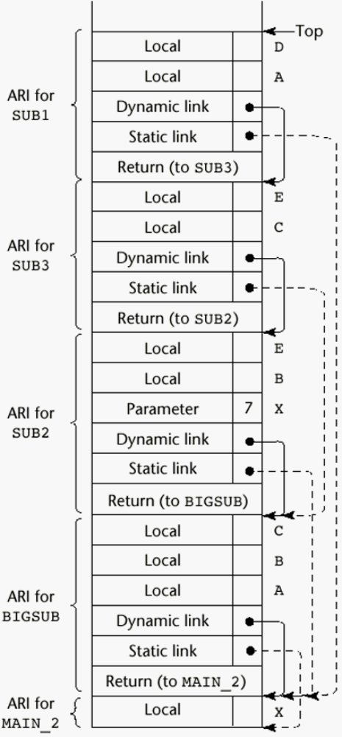
Stack Contents at Position 1

Slide 24
Displays
An alternative to static chains
Static links are stored in a single array called a display
The contents of the display at any given time is a list of addresses of the accessible activation record instances

Slide 25
Blocks
Blocks are user-specified local scopes for variables
An example in C
{int temp;
temp = list [upper];
list [upper] = list [lower];
list [lower] = temp
}
The lifetime of temp in the above example begins when control enters the block
An advantage of using a local variable like temp is that it cannot interfere with any other variable with the same name

Slide 26
Implementing Blocks
Two Methods:
  Treat blocks as parameter-less subprograms that are always called from the same location
    Every block has an activation record; an instance is created every time the block is executed
  2. Since the maximum storage required for a block can be statically determined, this amount of space can be allocated after the local variables in the activation record

Slide 27
Implementing Dynamic Scoping
Deep Access: non-local references are found by searching the activation record instances on the dynamic chain
Shallow Access: put locals in a central place
  One stack for each variable name
  Central table with an entry for each variable name

Slide 28
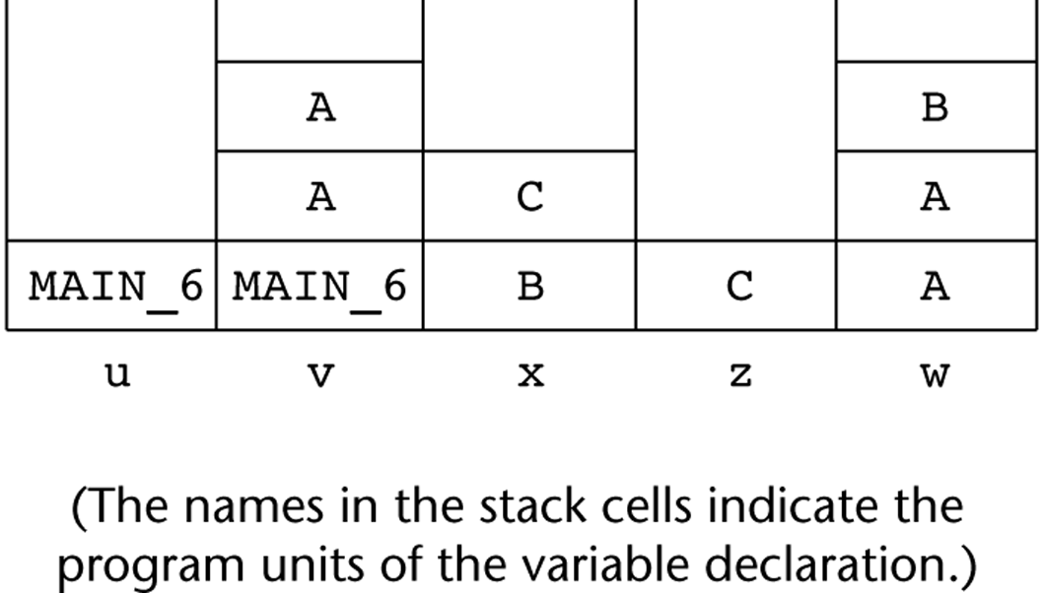
Using Shallow Access to Implement Dynamic Scoping

Slide 29
Summary
Subprogram linkage semantics requires many action by the implementation
Simple subprograms have relatively basic actions
Stack-dynamic languages are more complex
Subprograms with stack-dynamic local variables and nested subprograms have two components
  actual code
  activation record

Slide 30
Summary (continued)
Activation record instances contain formal parameters and local variables among other things
Static chains are the primary method of implementing accesses to non-local variables in static-scoped languages with nested subprograms
Access to non-local variables in dynamic-scoped languages can be implemented by use of the dynamic chain or thru some central variable table method

